Slide 1
影像處理、電腦視覺及深度學習概論 (Introduction to Image Processing, Computer Vision and Deep Learning) Homework 1
TA:
West: player210421@gmail.com
Office Hour: 17:00~19:00, Mon.
10:00~12:00, Wed.
At CSIE 9F Robotics Lab.

Slide 2
Notice (1/2)
Copying homework is strictly prohibited!! Penalty: Grade will be zero for both persons!!
If the code can’t run, you can come to our Lab within one week and show that your programming can work. Otherwise you will get zero!!
Due date =>23:59:59, 2020/11/O5 (Thu.)
No delay. If you submit homework after deadline, you will get 0.
Upload to => 140.116.154.1 -> Upload/Homework/OpenCv_Hw1
User ID: opencvdl2020 Password: opencvdl2020
Format
Filename: Hw1_StudentID_Name_Version.rar
Ex: Hw1_F71234567_林小明_V1.rar
If you want to update your file, you should update your version to be V2, ex: Hw1_F71234567_林小明_V2.rar
Content: project folder*( including the pictures ) *note: remove your “Debug” folder to reduce file size

Slide 3
Notice (2/2)
Python (recommended)
Python 3.7 (https://www.python.org/downloads/)
opencv-contrib-python (3.4.2.17)
Matplotlib 3.1.1
UI framework: pyqt5 (5.15.1)
C++ (check MFC guide in ftp)
OpenCV 3.3.1 (https://opencv.org/release.html)
Visual Studio 2015 (download from http://www.cc.ncku.edu.tw/download/)
UI framework: MFC

Slide 4
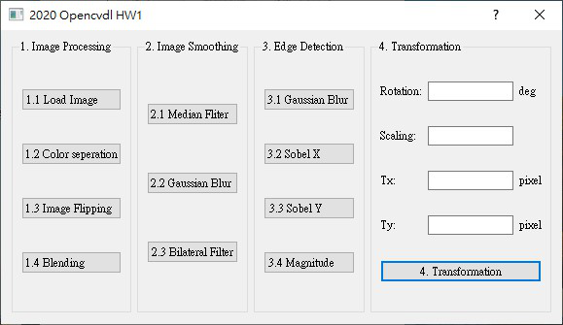
Assignment scoring (Total: 100%)
1. (20%) Image Processing
1.1 (5%) Load Image File
1.2 (5%) Color Separation
1.3 (5%) Image Flipping
1.4 (5%) Blending
2. (20%) Image Smoothing
2.1 (7%) Median filter
2.2 (7%) Gaussian blur
2.3 (6%) Bilateral filter
3. (20%) Edge Detection
3.1 (5%) Gaussian Blur
3.2 (5%) Sobel X
3.3 (5%) Sobel Y
3.4 (5%) Magnitude
4. (20%) Transforms:
4.1 (7%) Rotation,
4.2 (7%) Scaling,
4.3 (6%) Translation
5. (20%) Training Cifar-10 Classifier Using VGG16
(出題：Jimmy)
(出題：Brian)
(出題：Shan)
(出題：Jimmy)
(出題：Kevin)

Slide 5
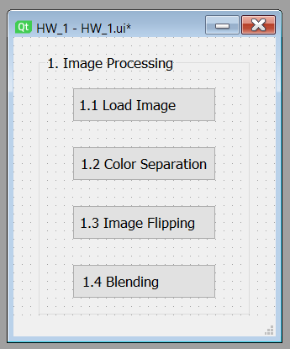
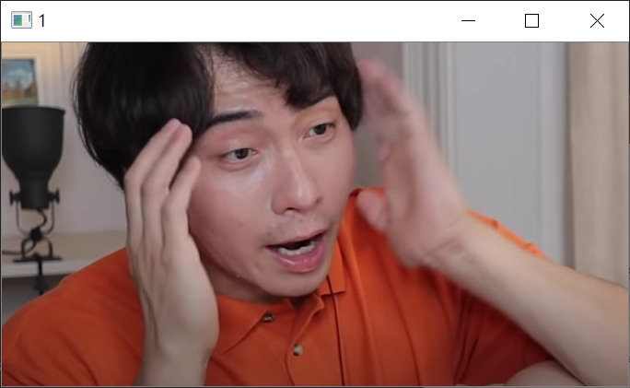
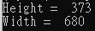
1.1 Load Image File
(出題：Jimmy)
Given: “Uncle_Roger.jpg” image
Q: 1) Open a new window to show the image (Uncle_Roger.jpg)
2) Show the height and width of the image in console mode
Hint : Textbook Chapter 2, p. 22~23
圖片出處: Youtuber Uncle Roger (https://www.youtube.com/channel/UCVjlpEjEY9GpksqbEesJnNA)

Slide 6
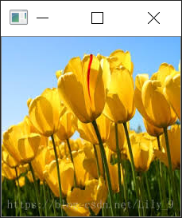
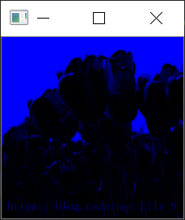
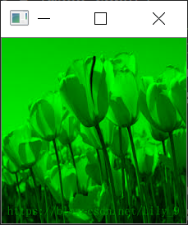
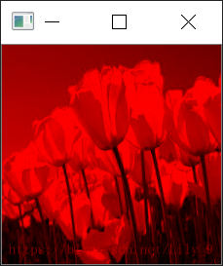
1.2 Color Separation
(出題：Jimmy)
Given: a color image, “Flower.jpg”
Q: 1) Extract 3 channels of the image BGR to 3 separated channels. 2) Open 3 new windows to show result images.
Hint: Textbook Chapter 3, p.31 ~ p.44

Slide 7

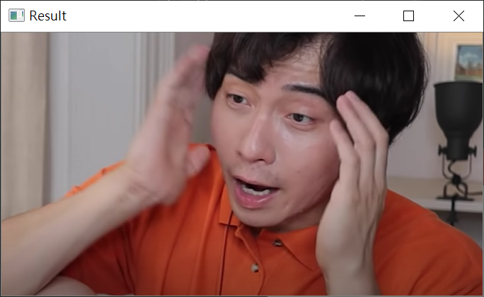
1.3 Image Flipping
(出題：Jimmy)
Given: an image, “Uncle_Roger.jpg”
Q: 1) Flip the image (Uncle_Roger.jpg) and open a new window to show the result.
Hint: Textbook Chapter 3, p.31 ~ p.44

Slide 8
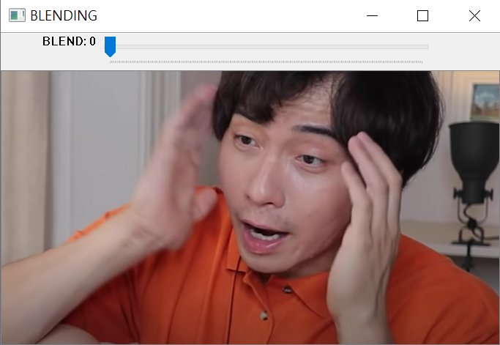
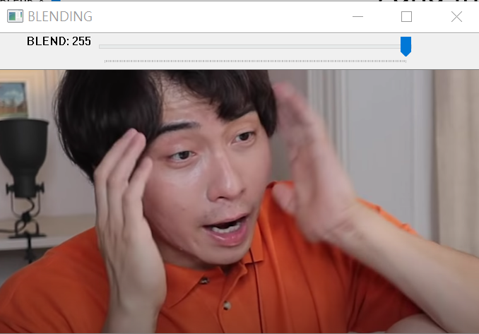
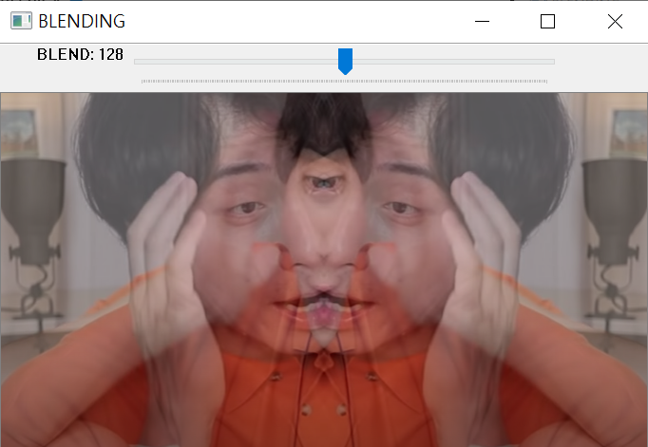
1.4 Blending
(出題：Jimmy)
Given: 2 images, “Uncle_Roger.jpg” and the result of 1.3
Q: 1) Combine two images (Uncle_Roger.jpg and the result of 1.3). 2) Use Trackbar to change the weights and show the result in the new window.
Hint:
Textbook Chapter 3, p. 51 ~ 51
cv2.createTrackbar(...) for Python

Slide 9
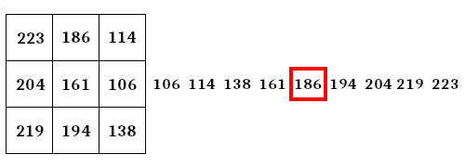
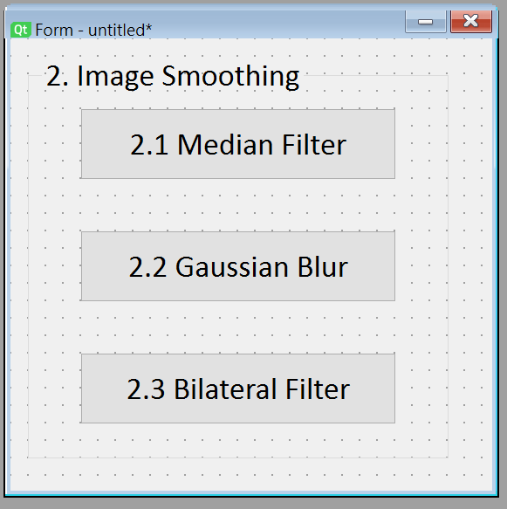
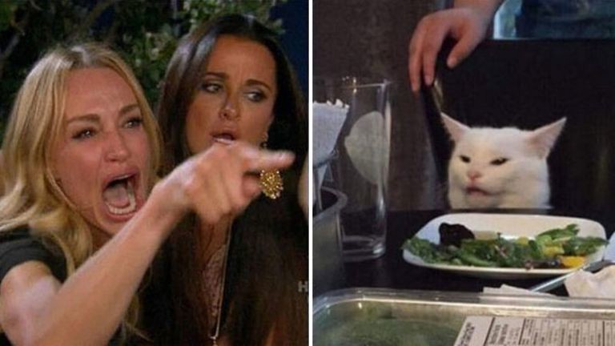
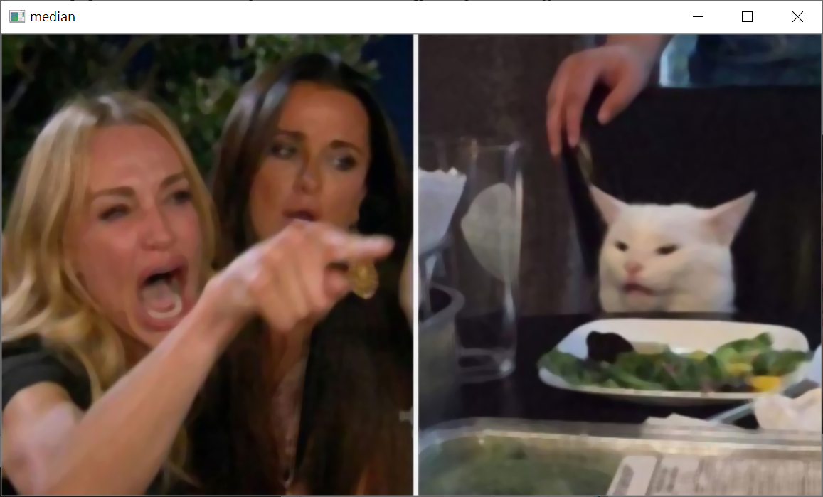
2.1 Median filter
(出題：Brian)
Given: a color image, “Cat.png”
Q: 1) Apply 7x7 median filter to “cat.png”
Hint: Textbook Chapter 5, p.109 ~ p.115
Median filter example

Slide 10
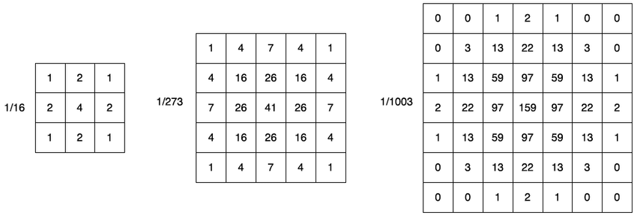
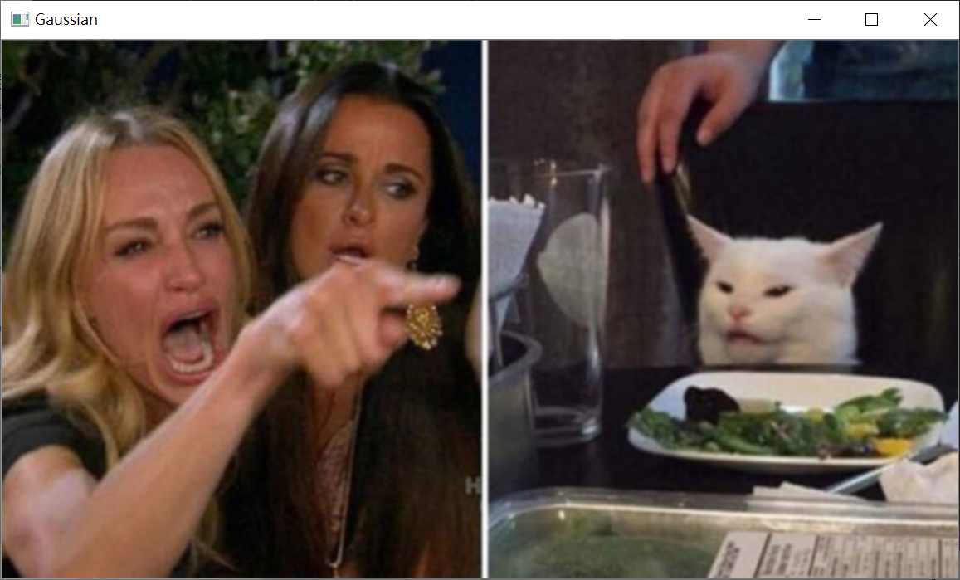
2.2 Gaussian Blur
(出題：Brian)
Given: a color image, “Cat.png”
Q: 1) Apply 3x3 Gaussian blur to “Cat.png”
Hint: Textbook Chapter 5, p.109 ~ p.115

Slide 11
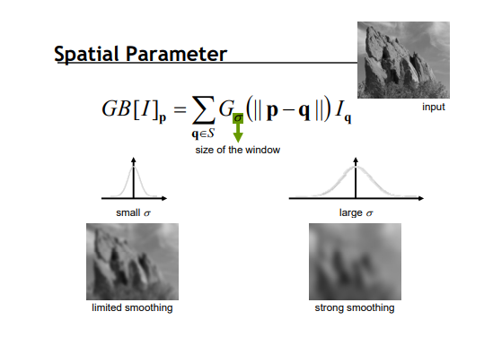

2.3 Bilateral filter
(出題：Brian)
Given: a color image, “Cat.png”
Q: 1) Apply 9x9 Bilateral filter with 90 sigmaColor and 90 sigmaSpace to “Cat.png”
Hint: Textbook Chapter 5, p.109 ~ p.115

Slide 12
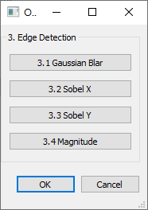
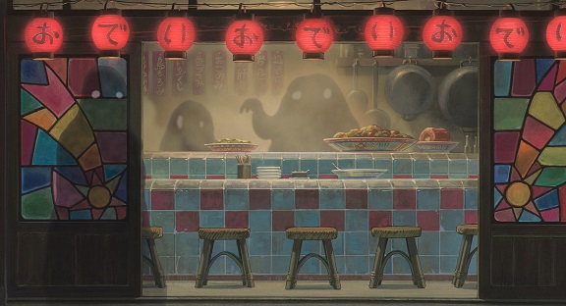
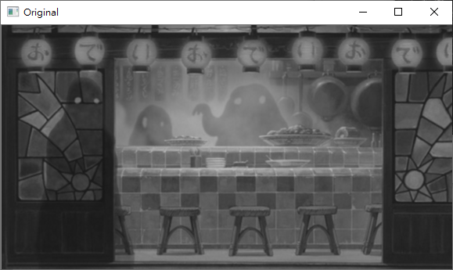

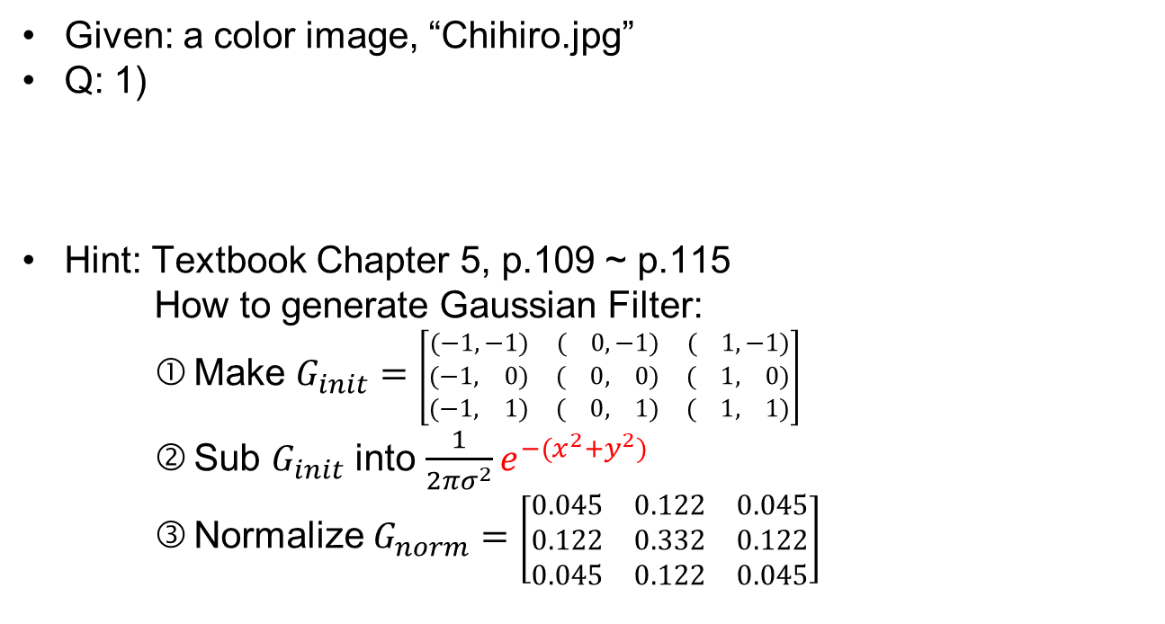
3.1 Gaussian Blur
(出題：Shan)
Given: a color image, “Chihiro.jpg”
Q: 1)
Hint: Textbook Chapter 5, p.109 ~ p.115
How to generate Gaussian Filter:
Make $G_{init}=$ $\left[\begin{matrix}(−1,−1) & ( 0,−1) & ( 1,−1) \\ (−1, 0) & ( 0, 0) & ( 1, 0) \\ (−1, 1) & ( 0, 1) & ( 1, 1)\end{matrix}\right]$
Sub $G_{init}$ into $\frac{1}{2πσ^{2}}e^{−(x^{2}+y^{2})}$
Normalize $G_{norm}=$ $\left[\begin{matrix}0.045 & 0.122 & 0.045 \\ 0.122 & 0.332 & 0.122 \\ 0.045 & 0.122 & 0.045\end{matrix}\right]$
Gaussian Blur: Convert the color image into a grayscale image, then smooth it by your own 3x3 Gaussian smoothing filter (Can not use OpenCV Function). Please show the result.
Chihiro.jpg
Grayscale
Gaussian Blur

Slide 13
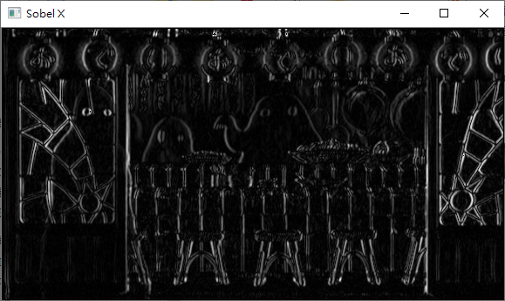
3.2 Sobel X
(出題：Shan)
Given: the result of 3.1) Gaussian Blur
Q: 2)
Hint: Textbook Chapter 6, p.148 ~ 149
If the image can not be show, please normalize the result to 0~255.
Sobel X: Use Sobel edge detection to detect vertical edge by your own 3x3 Sobel X operator (Can not use OpenCV Function). Please show the result.
-1 | 0 | 1
-2 | 0 | 2
-1 | 0 | 1
Sobel X
Gaussian Blur
Sobel X

Slide 14
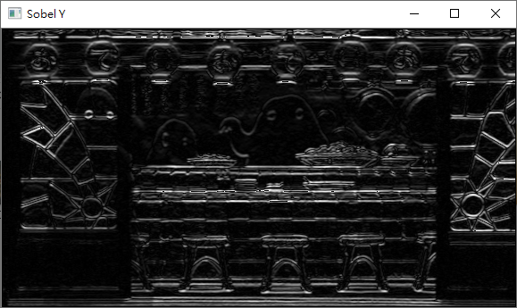
3.3 Sobel Y
(出題：Shan)
Given: the result of 3.1) Gaussian Blur
Q: 3)
Hint: Textbook Chapter 6, p.148 ~ 149
If the image can not be show, please normalize the result to 0~255.
Sobel Y: Use Sobel edge detection to detect horizontal edge by your own 3x3 Sobel Y operator (Can not use OpenCV Function). Please show the result.
1 | 2 | 1
0 | 0 | 0
-1 | -2 | -1
Sobel Y
Gaussian Blur
Sobel Y

Slide 15
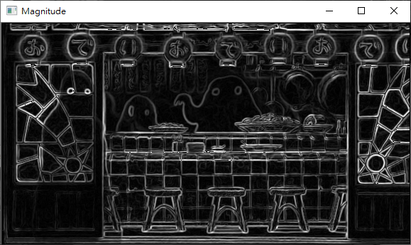
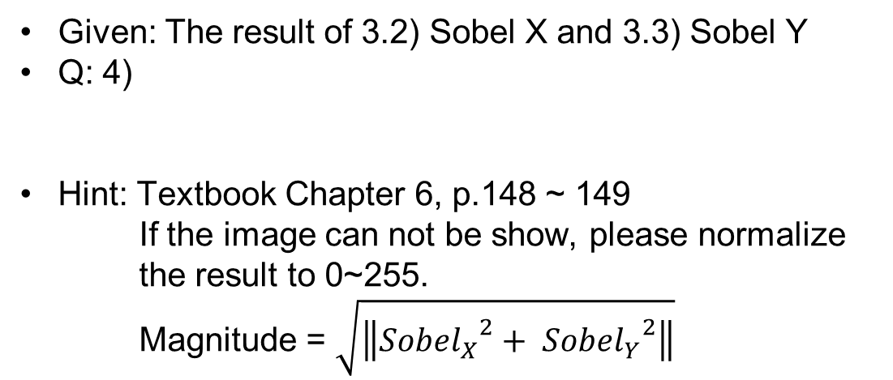
3.4 Magnitude
(出題：Shan)
Given: The result of 3.2) Sobel X and 3.3) Sobel Y
Q: 4)
Hint: Textbook Chapter 6, p.148 ~ 149
If the image can not be show, please normalize the result to 0~255.
Magnitude = $\sqrt{\left\|{{Sobel}_{X}}^{2}+ {{Sobel}_{Y}}^{2}\right\|}$
Magnitude: Use the results of 3.2) Sobel X and 3.3) Sobel Y to calculate the magnitude. Please show the result.
Sobel X
Magnitude
Sobel Y

Slide 16
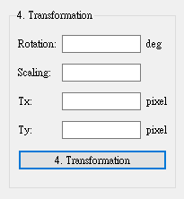
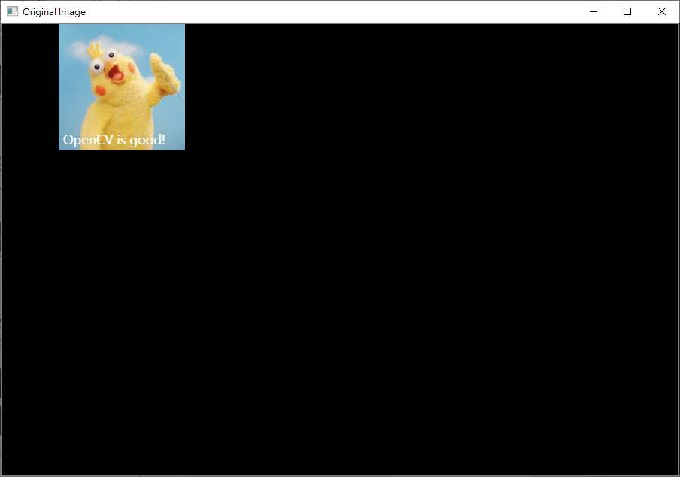
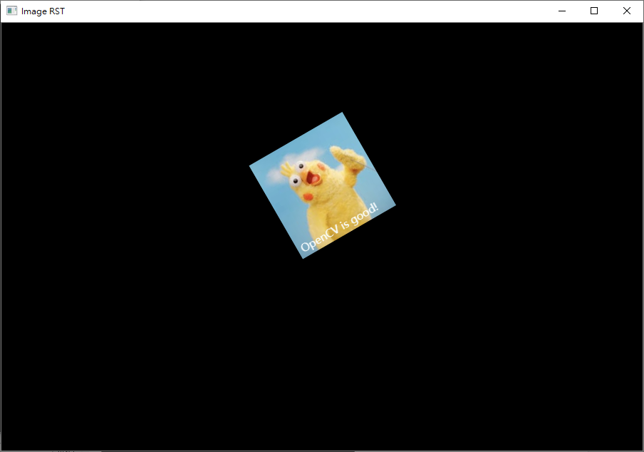
4.1 Transforms: Rotation, Scaling, Translation
(出題: Jimmy)
Given: “Parrot.png”
Q: 1) Click button “4. Transformation”, Parrot.png should be showed.
2) Please rotate, scale and translate the yellow parrot (as image below) with following parameters (should be entered in the GUI)
(1) Angle = 30º (counter-clockwise)
(2) Scale = 0.9,
(3) Translation with:
Xnew = Xold + 200 pixels = 160 + 200 = 360
Ynew = Yold + 300 pixels = 84 + 300 = 384
Point C (160, 84) is center of yellow parrot image
Hint: Textbook Chapter 12, (p.407 ~ 412) python: cv.warpAffine
EX:
(0,0)
Yellow parrot image
C (160, 84)
C’ (360, 384)
30º
Original image
After transformation

Slide 17
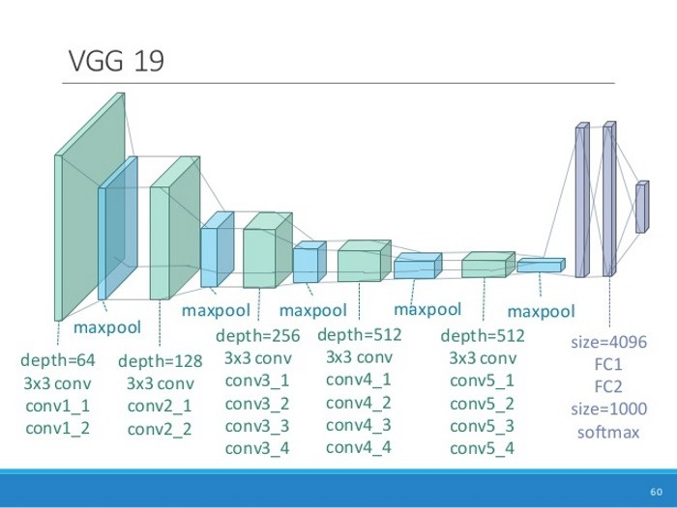
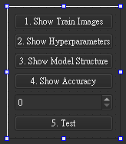
5.0 Training Cifar10 Classifier Using VGG16 (出題：Kevin)
Learn how to construct VGG16 and train it on Cifar10.
Environment Requirement
Python 3.6
Tensorflow 2 / PyTorch 1.3.0
opencv-contrib-python 3.4.2.17 (for image show and write)
Matplotlib 3.1.1 (for chart drawing)
Reference
Very Deep Convolutional Networks for Large-Scale Image Recognition(VGG16)
https://www.cs.toronto.edu/~kriz/cifar.html(Cifar10)
16
input(224x224x3)
input(112x112x64)
flatten
input(56x56x128)
input(28x28x256)
input(14x14x512)
2x2
2x2
2x2
2x2
2x2
10
GUI example
VGG16 framework

Slide 18
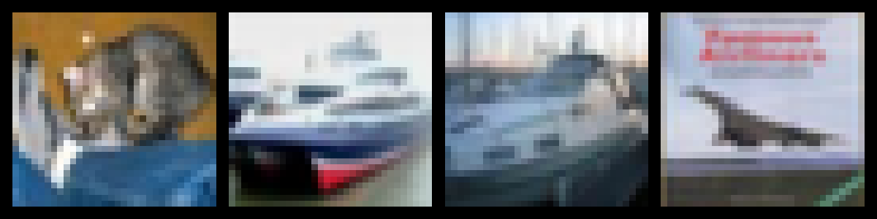
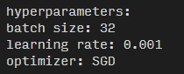
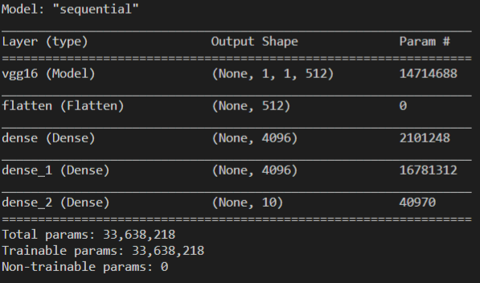
5.1 Load Cifar10 training dataset and randomly show 10 images and labels respectively. (4%)
5.2 Print out training hyperparameters (batch size, learning rate, optimizer). (4%)
5.3 Construct and show your model structure. (You can use available architecture provided by ML framework to build your model) (4%)
…
Label: cat ship ship airplane …
0 airplane
1 automobile
2 bird
3 cat
4 deer
5 dog
6 frog
7 horse
8 ship
9 truck

Slide 19
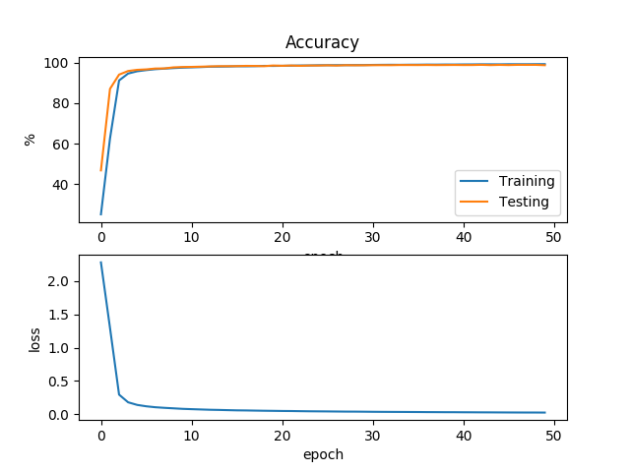
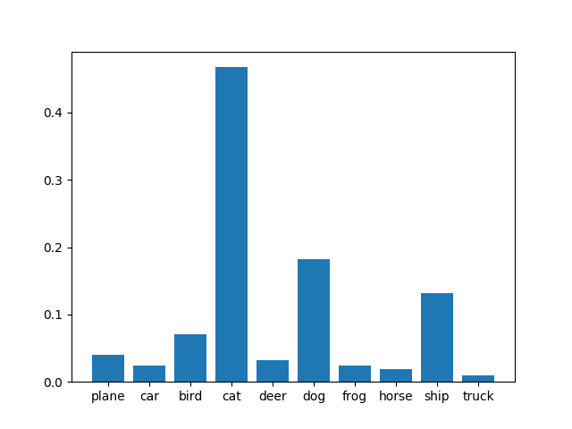
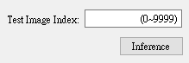
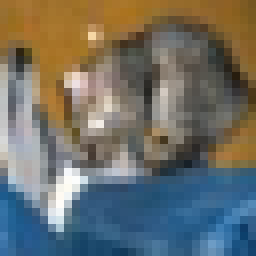
5.4 Training your model at least 20 epochs by your own computer, save your model and take a screenshot of your training loss and accuracy. No saved images no points (4%)
5.5 Load your model trained at 5.4, let us choose one image from test images, inference the image, show image and estimate the image as following. No saved model no points (4%)
(record accuracy/loss per epoch)

